Slide 1
SESSION:5
Registers

Slide 2
REGISTERS
A register is a group of flip flop with each flip-flop capable of storing one bit of information. An n-bit register has a group of n flip-flops and is capable of storing any binary information of n bits.Various types of registers are available.
Serial-Input Parallel Output
Series-In,Series-Out Register
Parallel-to-Serial Converter
Parallel in Parallel Out
Right Shift & Left Shift Registr

Slide 3
Serial-Input Parallel Output
In this type of shift register, the data is entered serially and output is obtained in parallel mode. In order to understand the working, let us make all the FLIP-FLOP cleared by applying a 0 to the clear input so that every output Q₀, Q₁, ……., Q₄ is 0. Then Cr is set to 1 and Pr is held constant at 1(by keeping the preset enable at 0). The serial data train and the synchronous clock are now applied. The least significant bit (LSB) is entered into FF4 when Ck changes from a 0 to a 1 by action of D type FLIP-FLOP. After the clock pulse, Q₄ = 1, while all other outputs remains at zero.

Slide 4
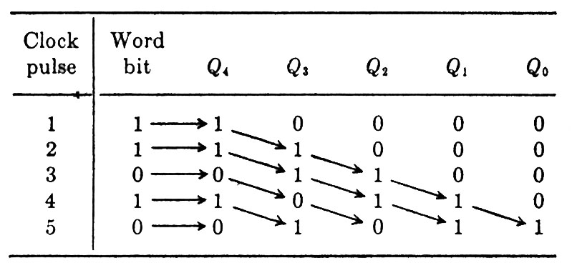

Slide 5
Series-In, Series-Out Register
We may take the output at Q₀ and read the register serially if we apply n clock pulses, for an n bit word. After the nth pulse each FLIP-FLOP reads 0. Note that the shift out clock rate may be greater or smaller than the original pulse frequency. Hence here is a method for changing the spacing in time of a binary code, a process referred to buffering.

Slide 6
Parallel-to-Serial Converter
Consider the situation where the word bits are available in parallel, e.g., at the outputs from an ROM. It is desired to present this code, say 01011, in serial form.
The LSB is applied to Pr₀, the 2¹ bit to Pr…., so that Pr₀=1, Pr₁=1, Pr₂=0, Pr₃=1, and Pr₄=0. The register is first cleared by Cr=0, and then Cr = 1 is maintained. A 1 at the present enable input activates all kth input NAND gates for which Prk = 1. The present of the corresponding kth FLIP FLOP is Pr = 0,and this stage therefore present to 1. In the present illustration FF0, FF1, FF3 are present and the input word 01011 is written into the register, all bits in parallel, by the present enable pulse.

Slide 7
Parallel in Parallel Out
The data are entered as explained above by applying a 1 at the preset, enable, or write terminal. It is then available in parallel form at the outputs Q₀, Q₁,..... If it is desired to read the register during a selected time, each output Q_{k} is applied to one input of a two-input AND gate N_{k} and the second input of each AND is excited by a read pulse. The output of N_{k} is 0 except for the pulse duration, when it reads 1 if Q_{k} = 1.

Slide 8
Right-Shift, Left-Shift Register
Some commercial shift registers are equipped with gates which allow shifting the data from right to left as well as in the reverse direction. One application for such a system is to perform multiplication or division by multiples of 2, as will now be explained. Consider first a right-shift register as in fig 9.1 and that the serial input is held low.

